Slide 1

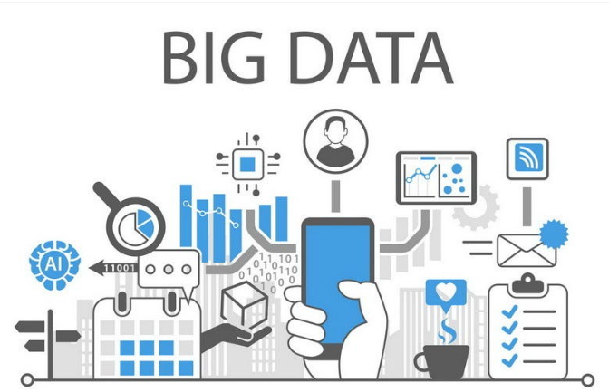
Big Data Project
Made by:
Isaac Ezimigbai Afedia

Slide 2
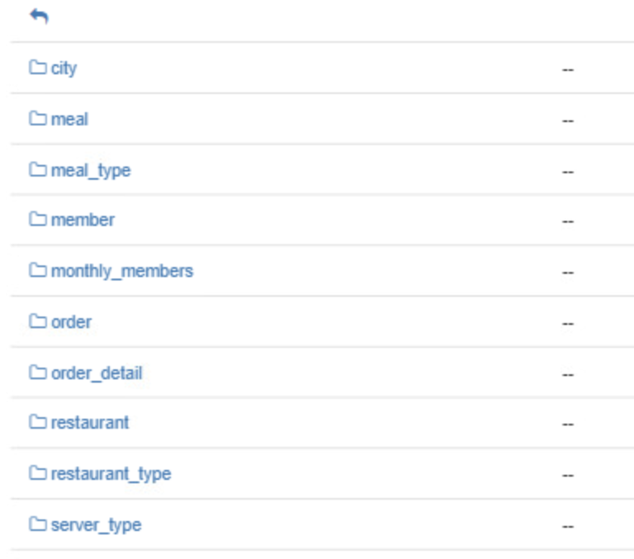
Dataset description
The dataset contains 10 CSV files, which contains the information about the restaurants in 5 different cities and for each restaurant it further contains the revenue, order details and meals information.

Slide 3
Prior to Analysis
For the Analysis part, to store the CSV file information we used Hadoop Distributed File System.
Related External Tables were created for each CSV file, to view the tables content to get started with Zeppelin.
In Zeppelin notebook based on 6 different analyzations. Dataset was visualized and provided the relative suggestion of improvement.

Slide 4
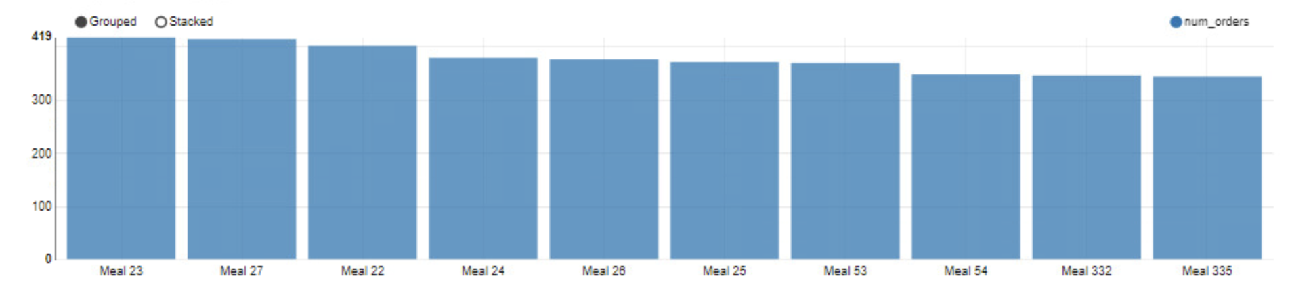
Popular Meals
By using the orders details data, we analyzed the number of orders of a specific meal which could help restaurants to optimize their menu offerings and pricing. Based on these results we found that meal 23 was the most ordered item and meal 335 was the least.

Slide 5
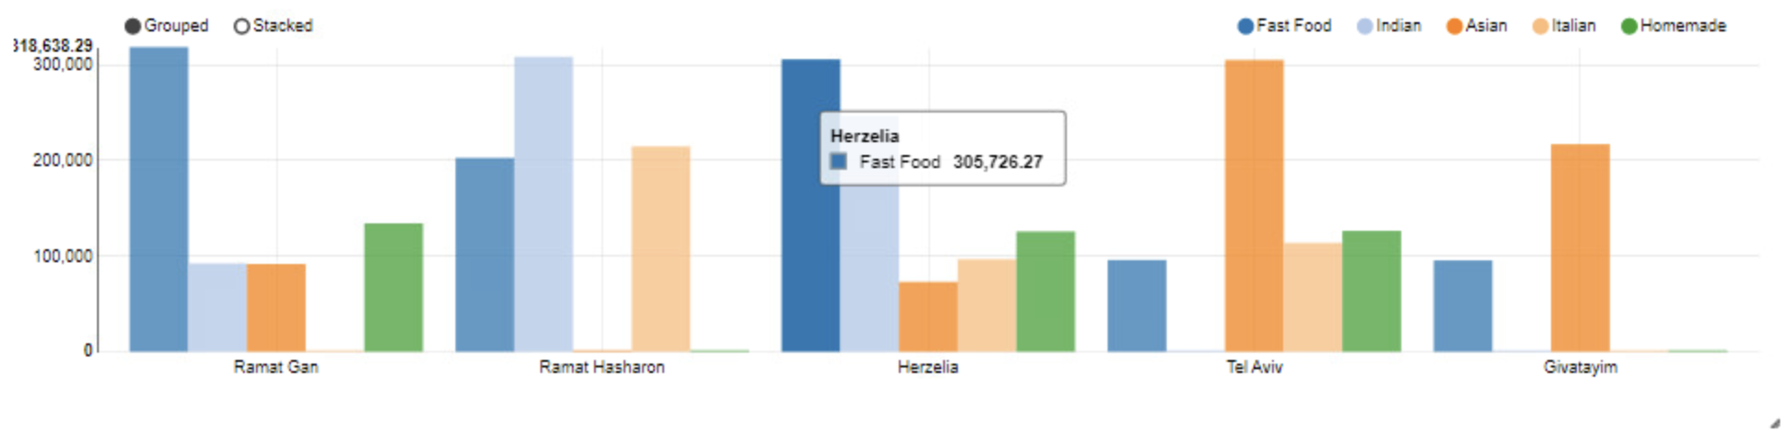
Revenue by City and Restaurant Type
Restaurant and orders data were used to view the revenue generated in 5 different cities. This could help to identify which cities and restaurant types are more profitable.
Based on this we analyzed that, fast food type restaurants has generated more revenue in Ramat Gan and Herzelia.
Moreover, Givatayim city has only generated revenues in Italian type restaurants.
By Analyzing these reports, we can decide which type of restaurants area more successful in different cities and based on that further openings of new restaurants can be decided.

Slide 6
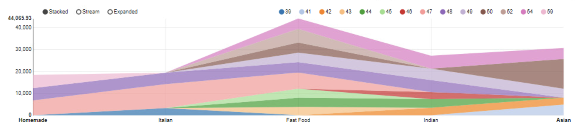
Restaurant Performance
By analyzing the revenue and member data, we could gain insights into which restaurants are performing the best and why.
This could help restaurants identify factors such as menu offerings, promotions, and customer service that are driving performance.
During the analyzation we found the fast food chain restaurants are more popular as it included most of the customers, whereas the homemade type restaurants contains the least number of unique customers.

Slide 7
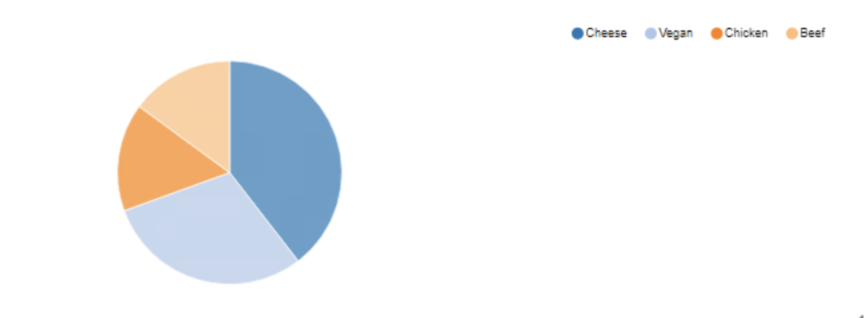
Revenue by Meal Type
By joining the meals and order details tables, we can calculate the total revenue for each meal type.
This can help restaurants identify which meal types are most profitable and adjust their menu offerings accordingly.
After analyzing we found that cheese meal type has more revenue generated as compared to the rest of the meal type.
Beef and the chicken generated less revenue as a meal type.

Slide 8
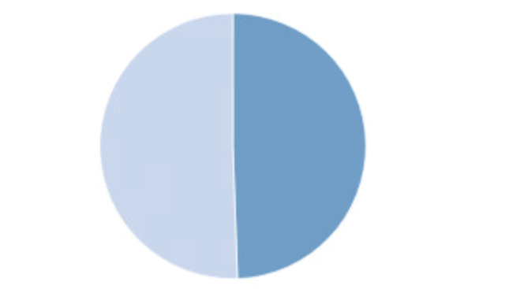
More Insights
More analyzation was done on dataset, such as comparing the average monthly spend by male and female which comes out to be approximately equal.
Based on this, we can identify any differences in spending patterns and adjust promotions and marketing accordingly.

Slide 9
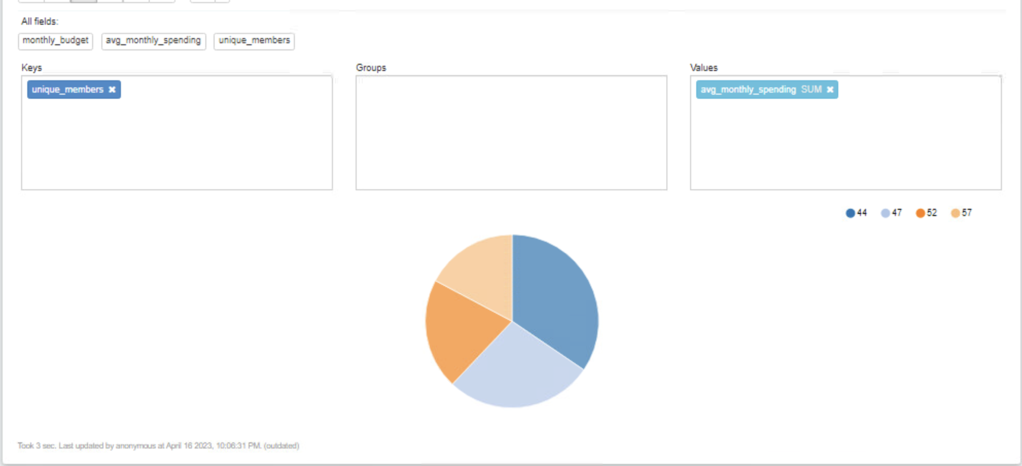
More Insights
By visualizing the monthly_members_total and Members tables, we could identify opportunities to optimize member budgets and improve member satisfaction.
This could involve offering more affordable menu options, creating promotions for budget-conscious members, or adjusting monthly budget allocations based on spending patterns.
We saw the less unique members of a particular city which is 44 has more average spend as compared to the rest.

Slide 10

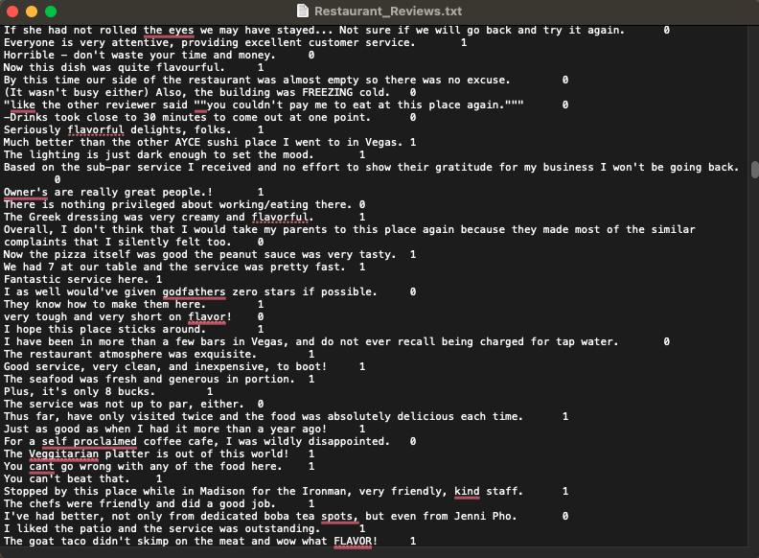
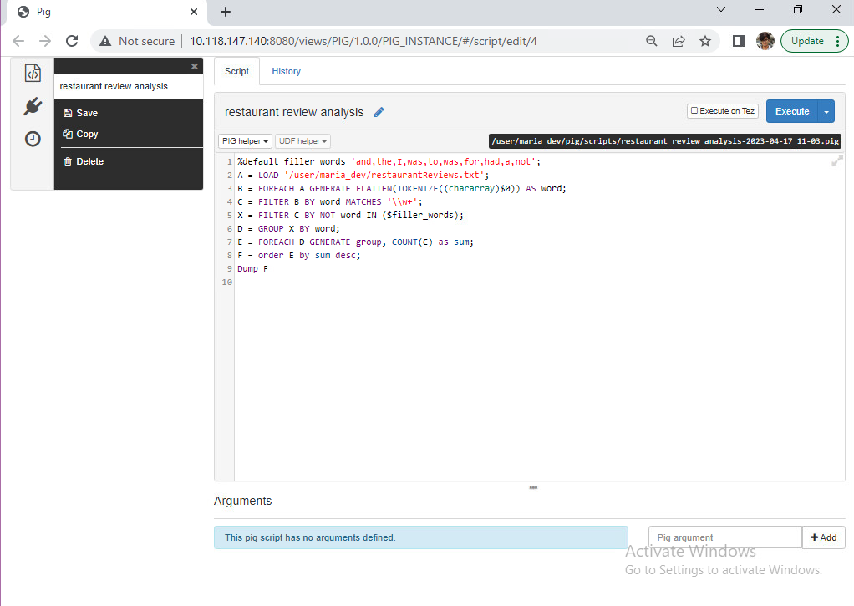
USING PIG TO ANALYZE CUSTOMER REVIEWS
Using a Text file with all customer reviews for a restaurant

Slide 11
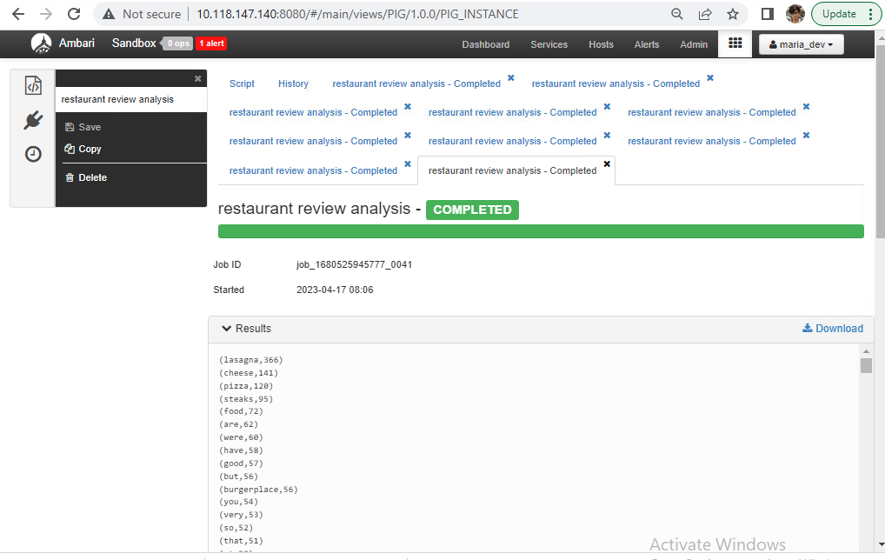
ANALYSIS BASED ON WORD COUNT

Slide 12
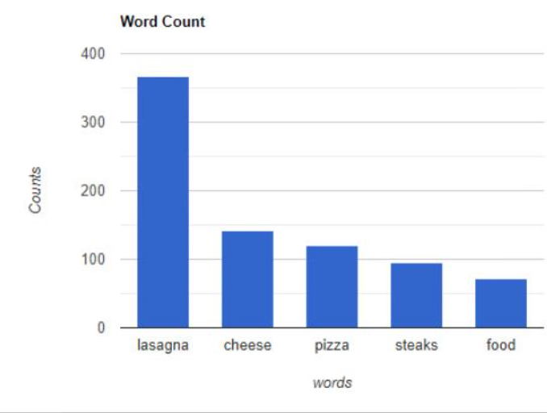
ANALYSIS BASED ON WORD COUNT
Based on the word count, we can say that foods like lasagna, pizza, and steak are the most reviewed dishes.
Using this data restaurants can get an idea, and focus more on their signature dishes, as most people tend to order the most reviewed item the most.
The restaurant can use these insights to set up promotional campaigns.
Sentiment analysis can also be done to know how the customer feels like after their visit to their restaurant.

Slide 13


THANK YOU

